Slide 1
Welcome
CS 472/572
Unsupervised Machine Learning
Spring 2025
Instructor: Dr. Khondker Fariha Hossain

Slide 2
Course Purpose
Introduces advanced topics in machine learning with emphasis on unsupervised and self-supervised methods
Explores key techniques:
Clustering
Dimensionality reduction
Modern representation learning
Focuses on discovering structure in unlabeled data
Applies methods across diverse domains:
Computer vision
Natural language processing (NLP)
Healthcare
Finance

Slide 3
Course Purpose
• Introduces advanced topics in machine learning, with emphasis on unsupervised and self-supervised methods
• Explores key techniques: clustering, dimensionality reduction, and modern representation learning
• Focuses on discovering structure in unlabeled data
• Applies methods across diverse domains: computer vision, natural language processing (NLP), healthcare, and finance

Slide 4
Assessment Breakdown
• Participation & Quizzes – 10%
• Midterm Exam – 20%
• Group Presentation on SOTA Papers – 30%
• Semester-Long Final Project – 40%

Slide 5
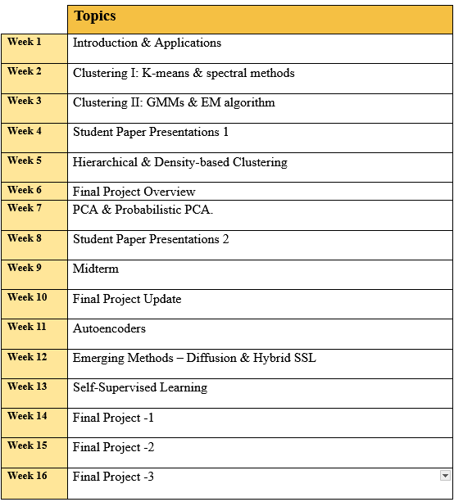
Tentative Weekly Schedule Overview

Slide 6
Student Learning Outcomes
By the end of this course, students will be able to:
• Explain core concepts of unsupervised and self-supervised learning
• Analyze problems and select appropriate algorithms
• Apply clustering and dimensionality reduction methods to data
• Evaluate algorithms using metrics and validation techniques
• Critically review and present state-of-the-art research
• Design and execute a semester-long project

Slide 7
Course Expectations & Policies
• Active participation and engagement in class
• Academic integrity is mandatory: plagiarism or cheating will not be tolerated.
• Professional communication (email, presentations)
• Respectful and inclusive classroom environment
• PROJECTS must be submitted on time (no late work)

Slide 8

Why Unsupervised Learning is Important?

Slide 9

Discover Hidden Structure in Data
• Finds patterns in unlabeled data
• Reveals natural groupings or clusters
• Provides insights without costly labeling

Slide 10

Simplify Data with Dimensionality Reduction
• Reduces complexity of high-dimensional data
• Improves visualization and interpretation
• Enables efficient storage and computation

Slide 11

Foundation for Self-Supervised Learning
• Builds on unsupervised principles
• Learns representations without labels
• Critical for pretraining large models

Slide 12
Supervised Vs Unsupervised Vs Self-Supervised Learning
Aspect | Supervised Learning | Unsupervised Learning | Self-Supervised Learning
Data Requirement | Requires labeled data (input-output pairs) | Works on unlabeled data | Uses unlabeled data, generates labels/signals automatically
Goal | Learn mapping from inputs → outputs | Discover structure, patterns, or groupings in data | Learn representations useful for downstream tasks
Examples of Tasks | Classification, regression (e.g., predicting price, spam detection) | Clustering, dimensionality reduction, anomaly detection | Pretraining language/vision models (BERT, SimCLR, MAE)
Advantages | High accuracy when labels are available; interpretable outputs | No labeling needed; discovers hidden structures | Scales to massive datasets; enables transfer learning
Limitations | Labeling is expensive, time-consuming, and domain-dependent | Hard to evaluate results; may find spurious patterns | Requires large datasets & compute; evaluation can be indirect
Use Cases | Medical diagnosis (labeled data), speech recognition, fraud detection | Market segmentation, document clustering, anomaly detection | Foundation models, NLP embeddings, vision pretraining

Slide 13

Applicable Across Domains
1.Cost-Effective:
• Removes need for expensive manual labeling
• Scales easily to large datasets
• Essential in domains with limited annotations
2. Supports Knowledge Discovery:
• Explores data without pre-defined categories
• Useful in exploratory analysis and science
• Drives hypothesis generation
3. Enhances Other Learning Methods:
• Extracts features to boost supervised learning
• Provides embeddings for transfer learning
• Improves hybrid model performance

Slide 14
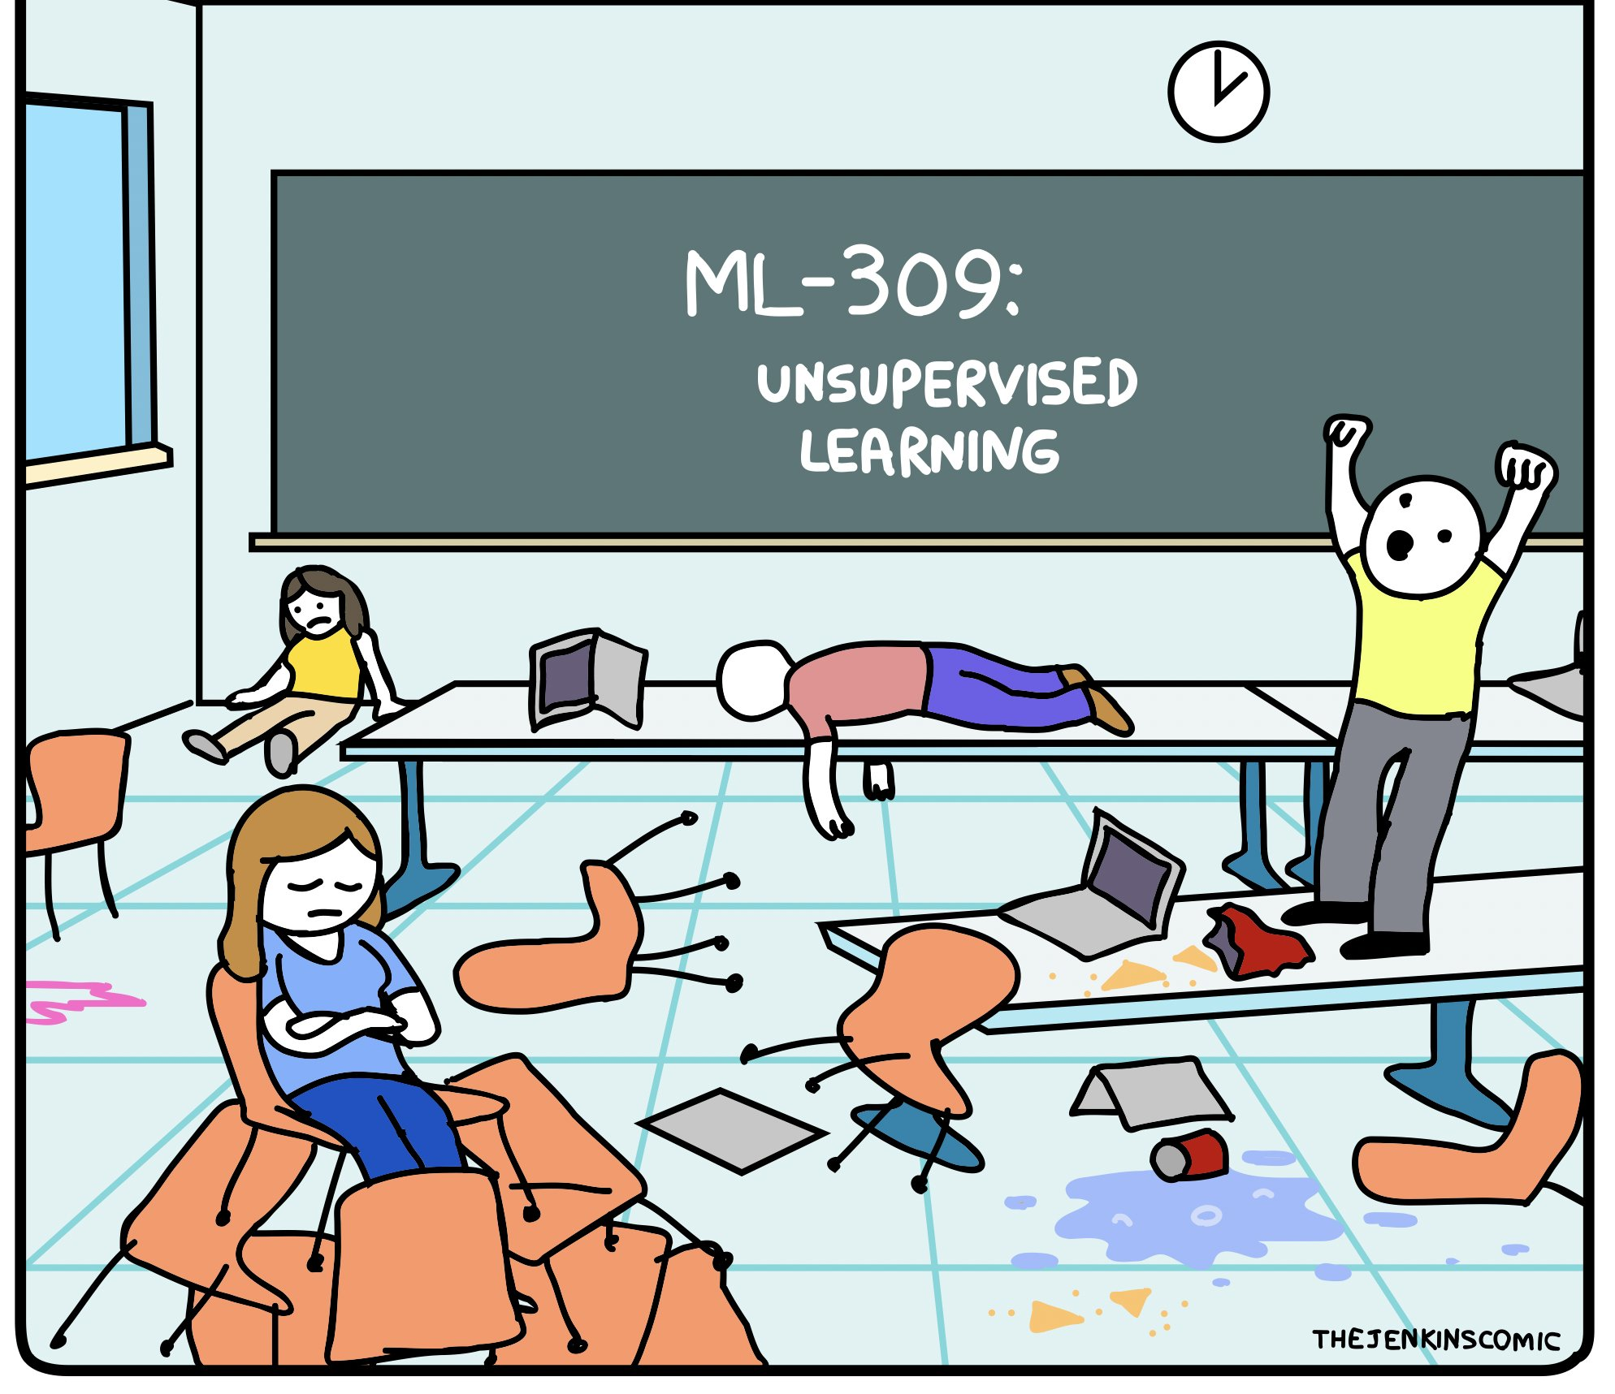
CS 472/572:

